Slide 1
9
Introduction to the Analysis of Variance

Slide 2
What if I have two groups of different people?
Single sample t
Dependent sample t
Independent sample t
We need the population mean

Slide 3
What about 3 groups?
Just do a lot of t tests
Too many t tests is type 1 error
ANOVAs
Uh what?

Slide 4
Analysis of Variance
Testing variation among the means of several groups
ANOVA
One-way analysis of variance

Slide 5
Basic Logic of ANOVA -1
Null hypothesis: several populations have the same mean
Research hypothesis: do the means of the samples differ more than expected if the null hypothesis were true?
Analyze variances – ANOVA
Two different ways of estimating population variance

Slide 6
Basic Logic of ANOVA -2
Estimating population variance from variation from within each sample
  Within-groups estimate of the population variance
    Not affected by whether the null hypothesis is true

Slide 7
Basic Logic of ANOVA -3
Estimating population variance from variation between the means of the samples
  Between-groups estimate of the population variance
    When the null hypothesis is true
    When the null hypothesis is not true

Slide 8
Basic Logic of ANOVA -4
The F ratio
  Ratio of the between-groups population variance estimate to the within-groups population variance estimate
The F distribution
The F table

Slide 9
Basic Logic of ANOVA -5
Sources of variation in within-groups and between-groups variance estimates

Slide 10
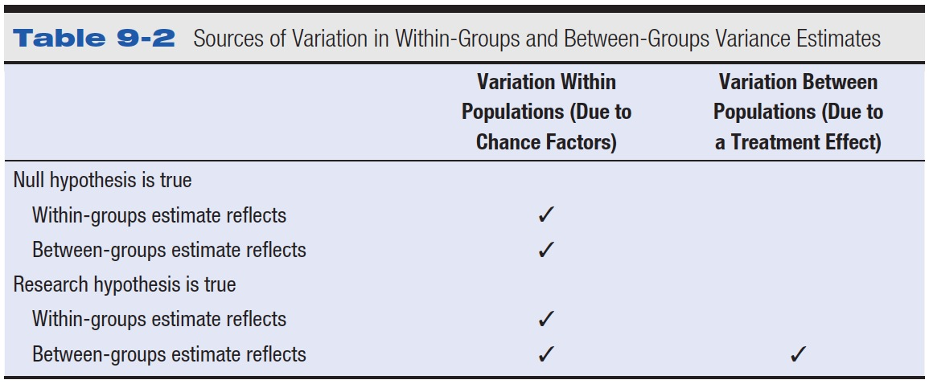
Table 9-2 Sources of Variation in Within-Groups and Between-Groups Variance Estimates

Slide 11
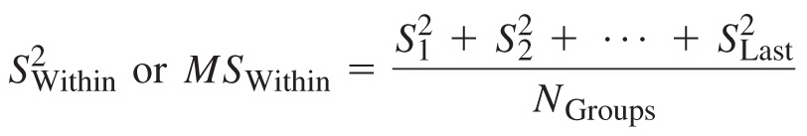
Carrying out an ANOVA -1
Estimating the population variance from the variation of scores within each group

Slide 12
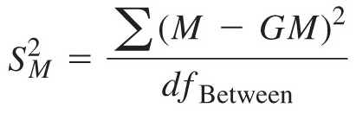

Carrying out an ANOVA -2
Estimating the population variance from the differences between group means
  Estimate the variance of the distribution of means

Slide 13

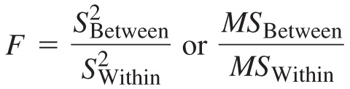
Carrying out an ANOVA -3
Estimating the population variance from the differences between group means
  Estimate the variance of the population of individual scores
  Figuring the F ratio

Slide 14
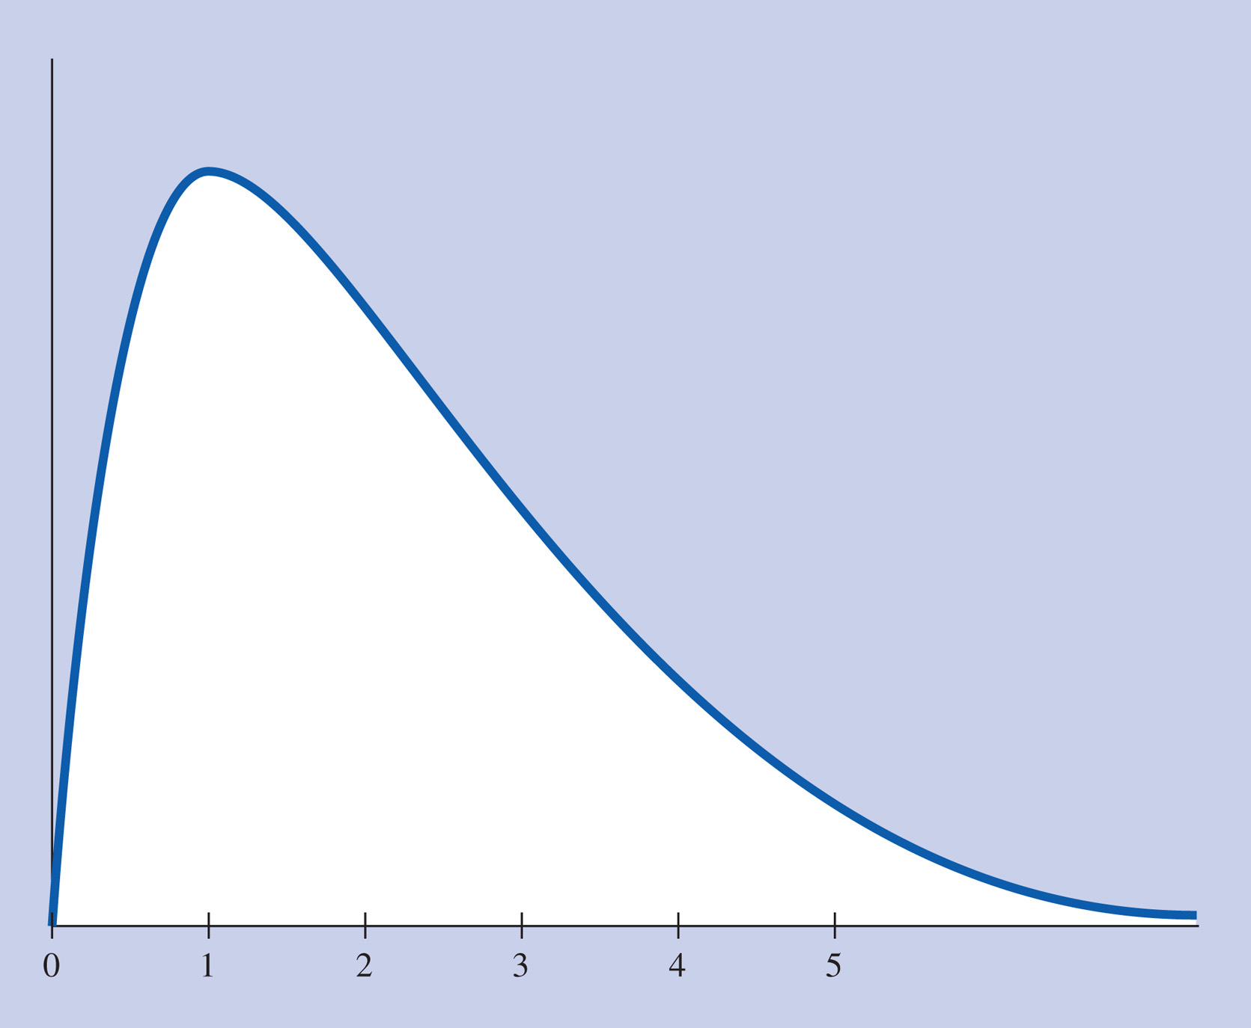
Carrying out an ANOVA -4
An F distribution

Slide 15


Carrying out an ANOVA -5
The F table
Between-groups degrees of freedom
Within-groups degrees of freedom

Slide 16
Assumptions in ANOVA
Populations follow a normal curve
Populations have equal variances
Copyright © 2009 Pearson Education, Inc. Upper Saddle River, NJ 07458. All rights reserved.

Slide 17
Hypothesis Testing
1. Restate the question as null/alt
  Null: All the groups are the same
  Alt: All groups have different means

Slide 18
Hypothesis Testing
2. Determine characteristics of the comparison distribution
  DF

Slide 19
Hypothesis Testing
3. Determine the cutoff score
  From the between groups and within groups degrees of freedom

Slide 20
Hypothesis Testing
4. Find your sample score
  F-ratio

Slide 21
Hypothesis Testing
5. Decide if you should reject the null hypothesis
  F-ratio > cutoff

Slide 22
Planned Contrasts/Post Hocs

Slide 23
After ANOVA
Planned contrasts are used when you know what combinations you want to use (hence the planned part).
Post Hocs are used when you don’t know what you expect or what to do ALL comparisons.

Slide 24
After ANOVA
Two ways to run planned contrasts / post hocs
  Run individual ANOVAs to get F-scores
  Run an independent t-test to get t-scores

Slide 25
Corrections
The problem with post hocs:
  Type 1 error when you start adding up comparisons
Solution: Corrections
Three Types:
  Tukey
  Bonferroni
  Scheffe

Slide 26
Post Hocs
Most popular is Tukey’s Test
  Advantage here versus planned comparisons is that you only have to run the test once.
  Tukey’s runs individual independent t-tests for each comparison
    (Is that really different than doing each one as an ANOVA with two groups?)
    t² = F

Slide 27
The Bonferroni Procedure -1
Divide the overall significance level by the number of planned contrasts
Use the resulting significance level for each comparison of a pair of means

Slide 28
The Bonferroni Procedure -2
5 planned contrasts = .05/5 = .01
3 planned contrasts = .05/3 = .017
4 planned contrasts = .01/5 = .0025

Slide 29
The Bonferroni Procedure -3
Bonferroni – so what do I do with .008?
  Make the chart!
  Compare the sig column.

Slide 30
Scheffe Test
Exploratory approach
Scheffé test
  Figure the F in the usual way
  Divide the F by the overall study’s df_{Between}
  Compare this to the overall study’s F cutoff

Slide 31
Overall Corrections
Bonferroni – changes the cut off score
Scheffe – changes the F-value to compare to the original cut off score
  Both are good tests.
  Bonferroni = better with small number of comparisons
  Scheffe = better with larger numbers of comparisons

Slide 32
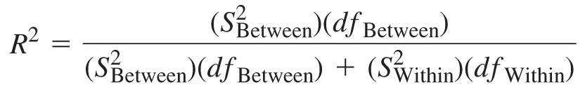
Effect Size for ANOVA -1
Proportion of variance accounted for (R²)

Slide 33
Effect Size for ANOVA -2
R² also known as η² (eta squared)
small R² = .01
medium R² = .06
large R² = .14

Slide 34
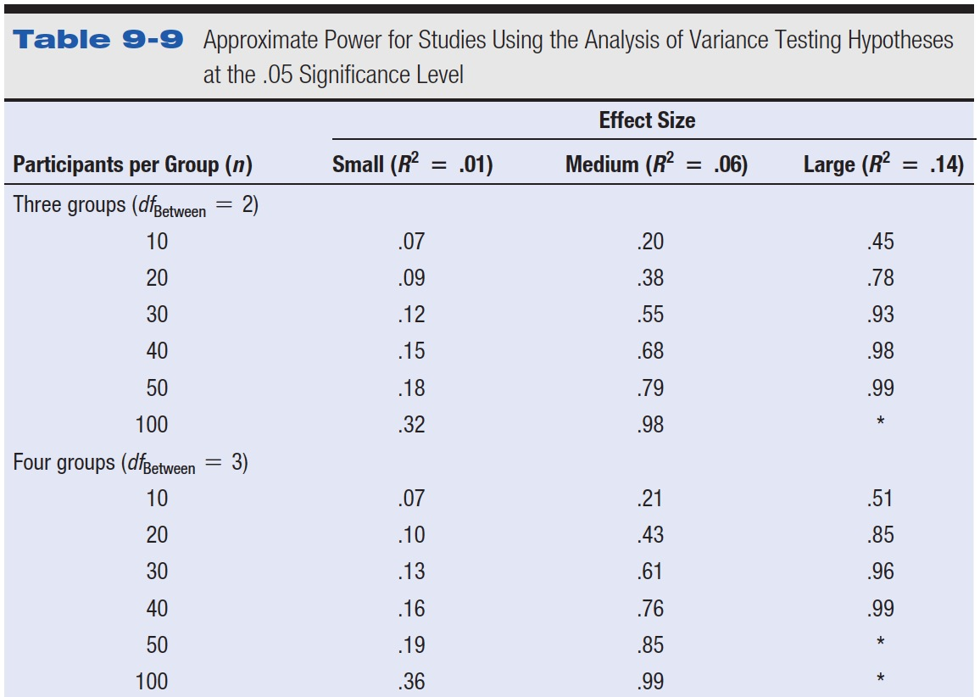
Table 9-9 Approximate Power for Studies Using the Analysis of Variance Testing Hypotheses at the .05 Significance Level

Slide 35
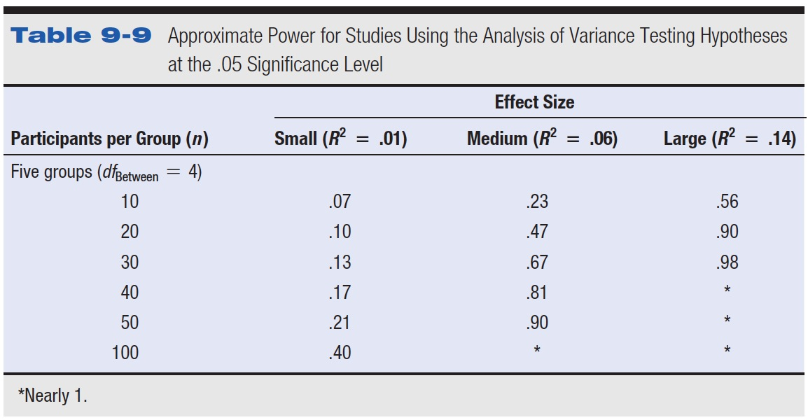
Table 9-9 (continued) Approximate Power for Studies Using the Analysis of Variance Testing Hypotheses at the .05 Significance Level

Slide 36
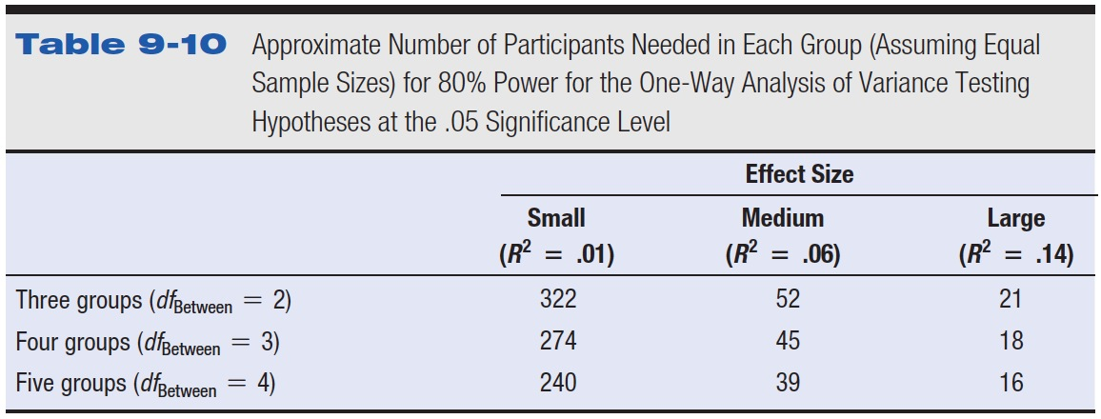
Table 9-10 Approximate Number of Participants Needed in Each Group (Assuming Equal Sample Sizes) for 80% Power for the One-Way Analysis of Variance Testing Hypotheses at the .05 Significance Level

Slide 37
Controversies and Limitations
Omnibus test versus planned contrasts
  Conduct specific planned contrasts to examine
    Theoretical questions
    Practical questions
  Controversial approach

Slide 38
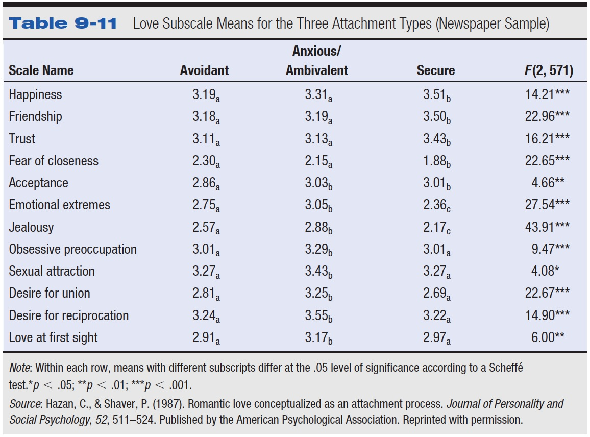
Table 9-11 Love Subscale Means for the Three Attachment Types (Newspaper Sample)

Slide 39
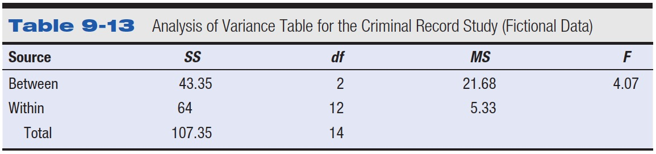
Table 9-13 Analysis of Variance Table for the Criminal Record Study (Fictional Data)

Slide 40
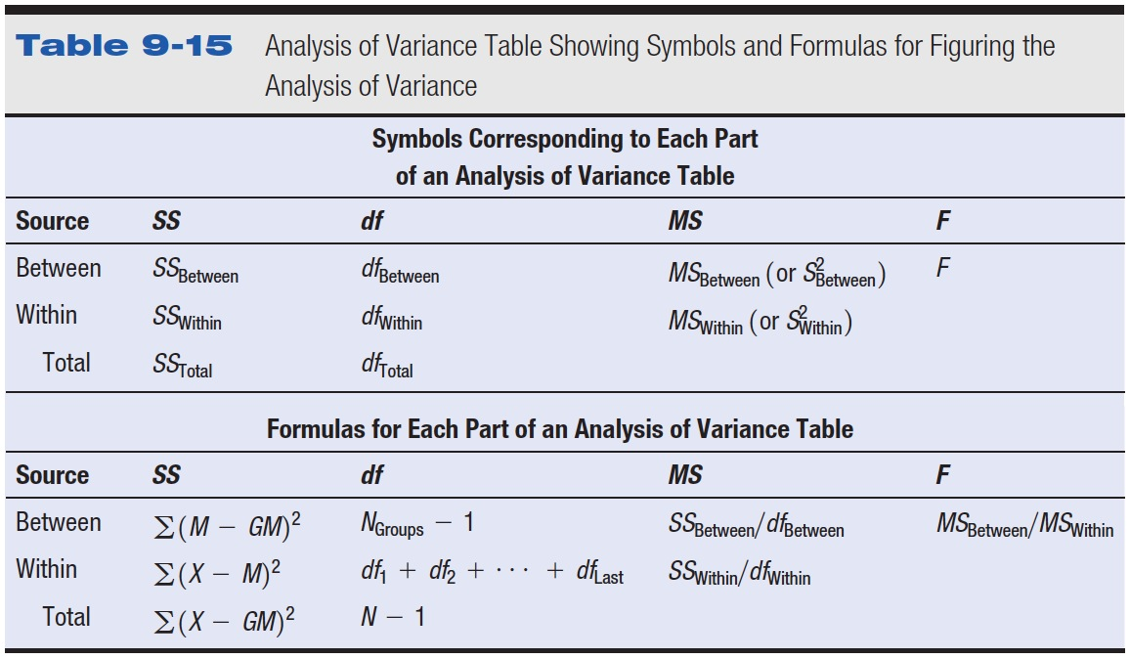
Table 9-15 Analysis of Variance Table Showing Symbols and Formulas for Figuring the Analysis of Variance

Slide 41
A sports psychologist gave a questionnaire about healthy eating habits to randomly selected professional athletes, four each from baseball, football, and basketball. The results were as follows.
Healthy Eating Habits Scores
Baseball Players Football Players Basketball Players
34 27 35
18 28 44
21 67 47
65 42 61

Slide 42
A team of clinical psychologists designed a study in which 12 psychiatric patients diagnosed as suffering from Generalized Anxiety Disorder were randomly assigned to one of three new types of long-term therapy labeled X, Y, and Z. After a year of therapy, the patients' overall mental health was assessed with the following results.
Mental Health Assessment
Therapy X Therapy Y Therapy Z
85 78 79
79 81 83
84 68 75
67 75 74

